Slide 1
CIRCULAR QUEUE

Slide 2
Session Outcomes
At the end of this session students will be able to:
To understand and implement CIRCULAR QUEUE data structure using ARRAY.

Slide 3
Why Circular Queue?
Once the queue is full, even though few elements from the front are deleted and some occupied space is relieved.
It is not possible to add anymore new elements, as the rear has already reached the Queue’s rear most position.
Front = 2
Rear = 6
30
40
20
60
14
0
1
2
3
4
5
6
Cannot be utilized

Slide 4
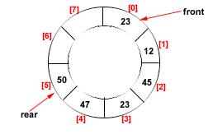
Circular Queue
It is a circular data structure where insertion is done at rear end, deletion and retrieval of data is done from front end.
FIRST IN FIRST OUT
Two special variables
Front
Rear

Slide 5
OPERATIONS OF CIRCULAR QUEUE
ENQUEUE
DEQUEUE
DISPLAY

Slide 6
Enqueue
Algorithm enqueue(o)
if (r+1)%N == f then
print “queue overflow”
else
Q[r] = o
r = (r+1)%N

Slide 7
DEQUEUE
Algorithm dequeue()
if f==-1 then
print “queue underflow”
else
o = Q[f]
f = (f+1)%N
return o

Slide 8
DISPLAY
Algorithm display()
if f==-1 then
print “queue empty”
else
for i = f to r
print Q[i]

Slide 9
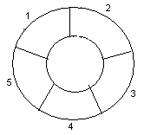
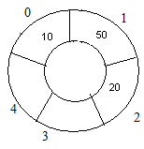
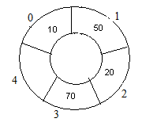
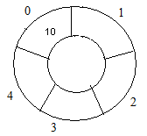
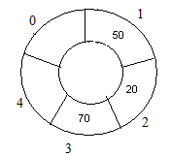
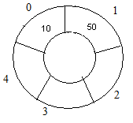
Example: Consider the following circular queue with N = 5.
1. Initially, Rear = -1, Front = -1.
4. Enqueue 20, Rear = 2, Front = 0.
Front
Rear
2. Enqueue 10, Rear = 0, Front = 0.
5. Enqueue 70, Rear = 3, Front = 0.
Rear
Front
Front
Rear
3. Enqueue 50, Rear = 1, Front = 0.
6. Dequeue front, Rear = 3, Front = 1.
Front
Rear
Front
Rear
09/10/08
9

Slide 10
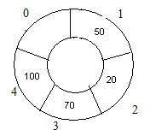
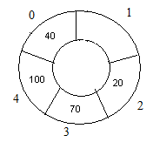
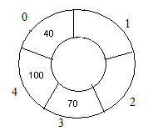
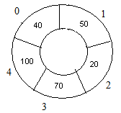
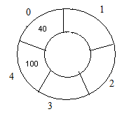
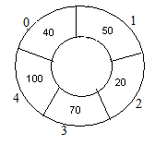
7. Insert 100, Rear = 4, Front = 1.
10. Delete front, Rear = 0, Front = 2.
Front
Rear
Front
Rear
8. Insert 40, Rear = 0, Front = 1.
11. Delete front, Rear = 0, Front = 3.
Rear
Rear
Front
Front
9. Insert 140, Rear = 0, Front = 1.
As Front = (Rear + 1)%N, so Queue overflow.
12. Delete front, Rear = 1, Front = 5.
Rear
Rear
Front
Front
09/10/08
10

Slide 11
PRACTICE PROBLEMS
Develop a menu driven program to implements CIRCULAR queue using ARRAY.
Develop a menu driven program which stores and manage the STUDENT information in CIRCULAR queue data structure.

Slide 12
Thank You

